Slide 1

Topic: Comparison of stock market performance among the US and Chinese tech companies, with respect to the Impact of the Covid-19 Pandemic
Student Name: Wong Chuen Lik Daniel
Student Number: 210763720
Supervisor Name: William Marsh
Programme of Study: MSc in Computing and Information System (Conversion)

Slide 2
Problem Statement
Analyze the impact of Covid-19 on stock markets in the US and China based on the total number of new cases
Evaluate and compare different classical models incorporating macroeconomic factors against the baseline model (ARIMA)
Notes:
extensive works of literature have been reviewed and summarized, sophisticated relationships behind the stock market particular in this uncertain environment
Real-life financial forecasting is often more complicated than the relationships described in the exploratory analysis section, but these depict a full picture of how the various actors play in the process of economic decision-making.
challenging to establish a robust model in stock price prediction, as the future is inherently unpredictable given the current unstable environment.

Slide 3
Outline of content
Background research
Literature Review
Data Source
Exploratory Analysis
Time Series Modelling
Classical Learning Modelling
Summary
Session 1
Session 2
Session 3
Notes:
This project is integrated with 3 Main parts: Background Study, Exploratory Analysis, and Data Modelling

Slide 4
1
Background research & Literature Review

Slide 5

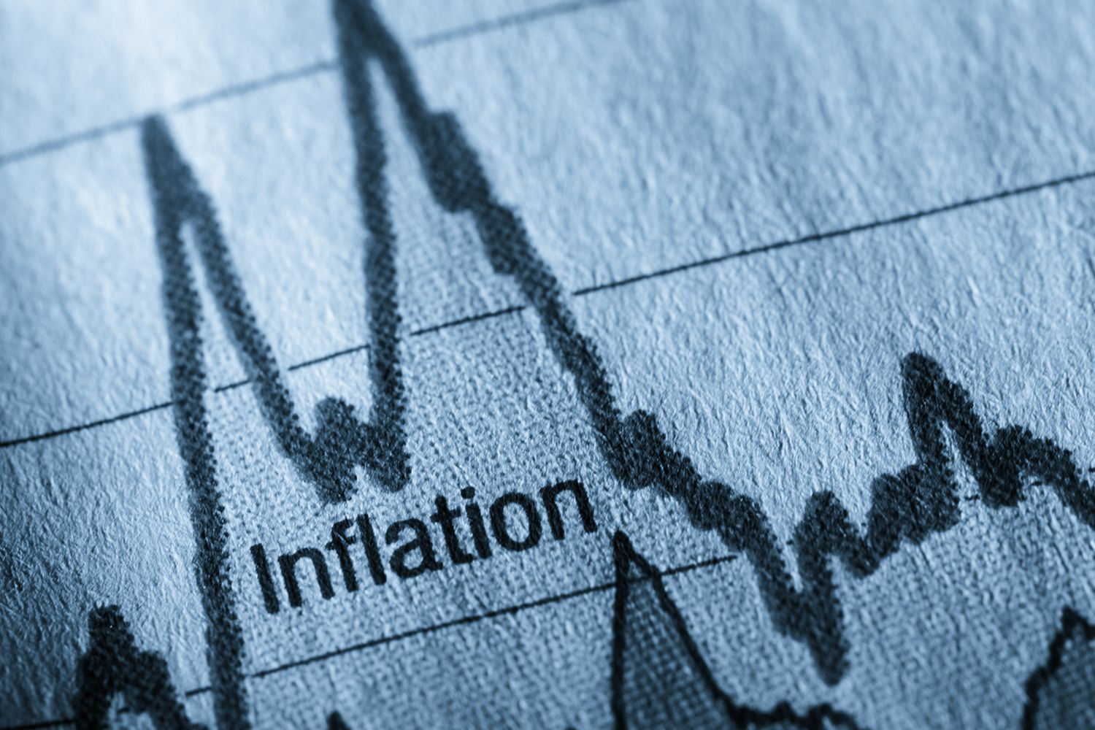

Background
A brief of the current macroeconomic situation across the world
2019 – current
The inflation Environment
Ongoing increase of CPI in the US
Tapering and rising interest rate
The Covid-19 Pandemic
Social Distance -> WFH policy / Shutdown
Different public policies against Covid-19
Emerging technology in the pandemic (e.g., “click and Mortar” and “live commerce”)
Thrive of Zoom and Netflix
2021-2022
Notes:
The US Federal Reserve announced the plan of tapering and rising interest rate in Nov 2021
taper = reducing securities purchases
New Legislations against anti-monopoly / ongoing War between Russia and Ukraine
4 Primary markets: commodities, bond prices, stocks, and currencies.
Inverse relationship between interest rate and bond prices
stock head down eventually if bond down

Slide 6
Literature Review
4 Literature Articles
Predicting attributes:
Exponential moving average of stock prices (EMA_10)
Covid-19 new cases
Composite index of government response
CPI
Unemployment rate
Stock Returns based on social media content (knowledge-based)
2nd Classical Learning Model: SVR model
Highlighted that individual investors tend to rely on stock information (i.e., News)
Highlighted Support Vector Regression (SVR) is the most effective model in stock price prediction
2
4
1
3
1st Classical Learning Model: Linear Regression model
Time Series Model:
ARIMA model (baseline model)
Univariate input attribute: Actual stock prices
Used one of the popular technical indicators – exponential moving average (EMA) as the input feature
Highlighted that ARIMA models are robust and efficient in financial time series forecasting
Good at short-term prediction
Notes:
1. Fundamental knowledge about the behaviour of investment decision of individual investor
2.
3. Included linear regression, and Support vector regression (SVR)
4. Predict future value based on actual/ past value

Slide 7
Data Source
5 Data sources
Time Series Data
Covid-19 New Cases
New_cases
Downloaded from World Health Organization (2022)
Justification of chosen stocks
The 15 and 10 top tech companies in the US and China were chosen according to their market cap
NDX (US) / FXI (China)
Stock Price
Downloaded from Yahoo Finance (2022)
Restriction_gathering
The Oxford Covid-19 Government Response Tracker (OxCGRT)
Specific stocks were chosen by groups for exploratory analysis (e.g., Tesla vs Zoom, Shopify vs PDD, Netflix vs Bilibili)
Downloaded from Blavatnik School of Government (2022)
CPI
Consumer Price Index (CPI)
Downloaded from Office for National Statistics (2022) and Trading Economics (2022)
Unemployment Rate
Unemployment
Downloaded from Trading Economics (2022) and Federal Reserve Economic Data (2022)
Notes:
OxCGRT collects and tracks different policy responses that governments have taken to cope with COVID-19 since 1 January 2020, covering more than 180 countries. This is a composite measure of 23 indicators, such as school closures, travel restrictions, face covering, vaccination policy, etc.
CPI can be deemed equivalent to the inflation rate. It is an indicator playing an important role in economic decision-making
Rather than GDP, unemployment rate is chosen in this project as GDP is somehow already reflected on CPI and GDP is not always an accurate measure of economic growth.

Slide 8
2
Exploratory Analysis
Macroeconomic factors
Comparison of stocks by groups
Covid-19 new cases vs stock prices
CPI & Unemployment rate Vs stock prices

Slide 9
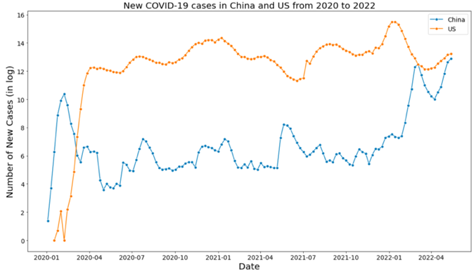
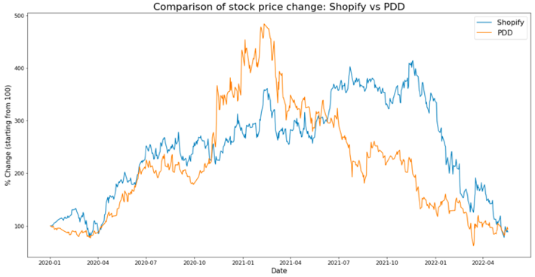
Exploratory Analysis
Comparison of macroeconomic factors
and specific stock prices by country
New Covid-19 Cases in China and the US from 2020 to 2022
China had more Covid-19 new cases than the US before Apr 2020 (aka the first wave),
the US overtook China after that (aka the second wave).
Comparison of stock price change: Shopify vs PDD
solely focus on online shopping platforms
extensively benefited from the Covid-19 pandemic
reach approximately 450% and 350% growth in Mar 2021 respectively
Notes:
Compared the difference between the US and China for each macroeconomic factor and stock price in some specific sectors
1. Significant difference …
Imply different country has different stock prices due to pandemic (consider the factor in economy as well)
2. Chosen Shopify and PDD…

Slide 10
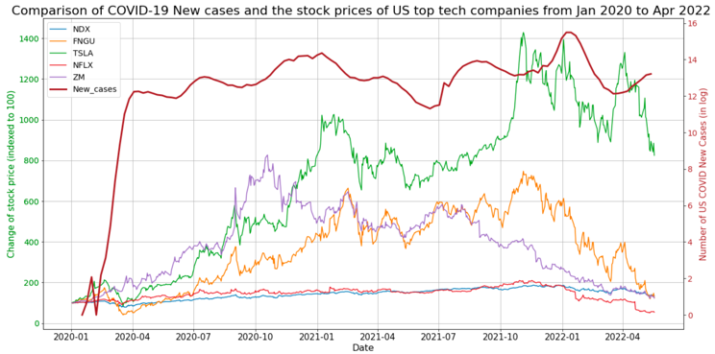
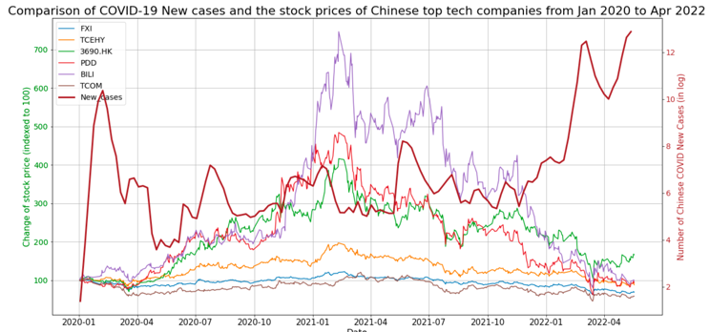
Exploratory Analysis
Covid-19 new cases
Vs Stock Prices in tech companies
Most of stocks in the US market started declining in Nov 2021
Performance of FNGU (covered the 10 biggest American tech companies) > NDX (Nasdaq 100 Index)
Revealed that the COVID-19 pandemic has posed a negative impact on the US stock market
A significant diversion occurred in the Chinese tech stock market
'Trip.com experienced a slump in the market due to the low demand for travelling
Bilibili, Meituan, and PDD were performing extraordinary (which are the prevailing Chinese video streaming service; Food and grocery delivery; Emerging online shopping platform)

Slide 11
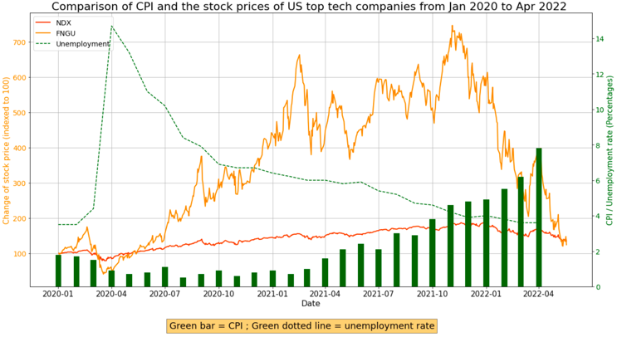
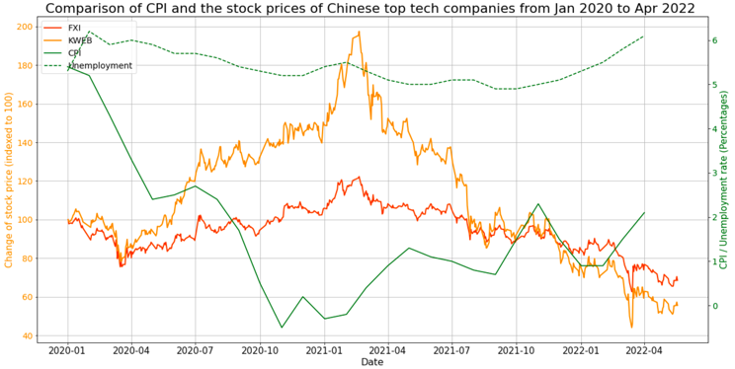
Exploratory Analysis
CPI & unemployment rate
vs Stock Prices in tech companies
In theory: Unemployment ⬇️ = Economic output ⬆️ (Okun's law, 1962)
In theory: small amount of inflation can help drive economic growth
Hence anticipated a growing economy in the US
Result: both Nasdaq 100 index and FNGU have been growing upward from Apr 2020 to Dec 2021, and then dropped dramatically due to the current “hard landing” policy (tapering and rising interest rates).
A relatively low inflation rate (CPI) and high unemployment rate
Negative CPI (-1%) implied a deflation environment for a short period
FXI (covers an array of Chinese tech and financial companies) and KWEB (mainly composed of China Internet companies), reached peaks at approximately 120% and 190% in Feb 2021, and returned to only 60% and 75% in Apr 2022 respectively.

Slide 12
3.1
Time Series Model (baseline)
ARIMA Model

Slide 13
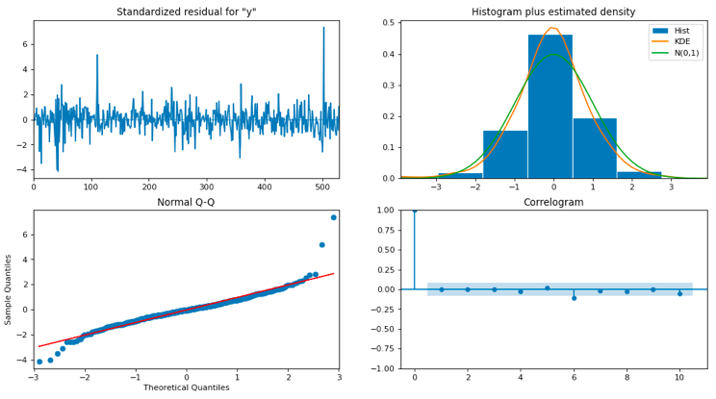
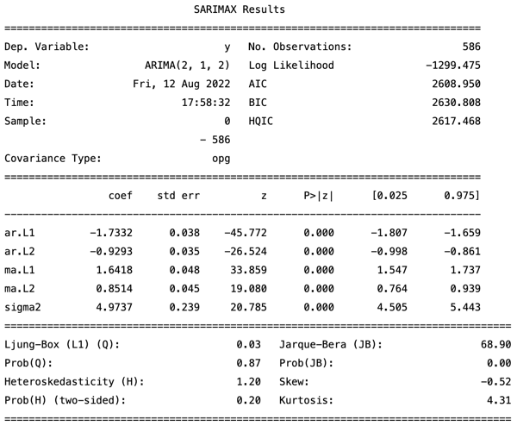


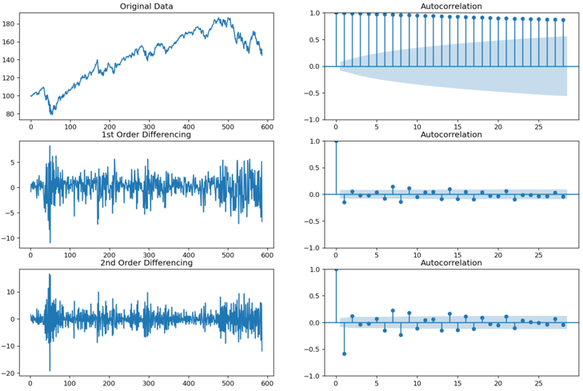

Time Series modelling
Set up of parameters (p,d,q) in ARIMA
Review of Residual plots (by calling plot_diagnostics)
Left top: Residual error, should be close to mean 0
Right top: suggests normal distribution with mean zero
Left bottom: all dots should fall in line with the red line
Right bottom: ACF plot, shows the residual errors are not autocorrelated
Differencing
Visualization of Autocorrelation function (ACF) to identify trend and autocorrelation
Determine the degree of differencing (d)
Observe and compare values in statistical summary
Utilize the scores in Akaike Information Criteria (AIC) and p-value
p-value<0.05 and a lower AIC is preferred
Determine the number of lag (p) and the size of moving average window (q)
Notes:
ARIMA model is defined by three parameters – p, d, q, where p, d, and q denote the number of lagged observations, the number of differencing for raw data, and the size of the moving average window respectively.
There are numerous approaches to find out the optimal ARIMA parameters. We used a manual approach instead of using the function auto_arima to search the best parameter automatically, as the function take into account runtime and sometimes may have error and bias. Simply put, we have validated the correlation and model performance with the aid of Autocorrelation function (ACF) plots, summary statistics and residual plot.
As an autoregressive model essentially is a linear regression, it is necessary to ensure that the time series data is stationary, by using differencing in ARIMA. By visualising the ACF plots, we could identify the trend and autocorrelation in data and thus determine the degree of differencing (d).

Slide 14
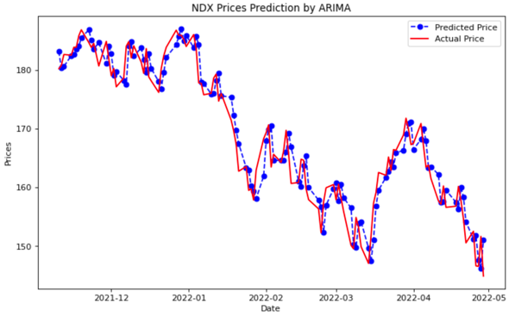
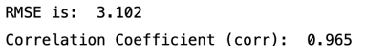
Time Series modelling
Results
A comparison of the predicted price and actual price of NDX
Shows an excellent result with a very low RMSE (3.1) and a high correlation coefficient (0.965).
Similar result (slightly better) is shown in the China dataset
Limitation: only presents the price prediction within the period in test data,

Slide 15
3.2
Classical Learning Model
Simple Linear Regression
Polynomial Regression
SVR with linear kernel
SVR with ‘RBF’ kernel
Notes:
RBF = radial basis function , default kernel used in support vector machine (SVM) classification

Slide 16
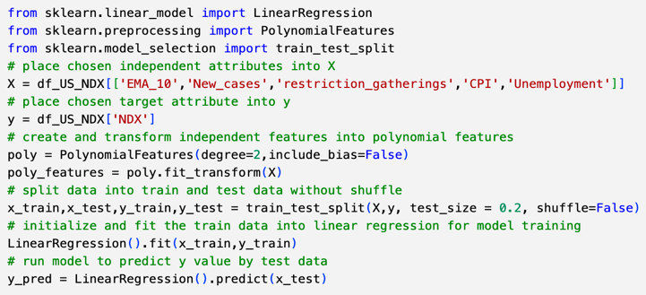
Classical learning modelling
Aims and Set up
Aims: implement and evaluate the effectiveness of classical models by utilizing the macroeconomic factors as input attributes. The models include Linear Regression, Polynomial Regression, and Support Vector Regression (SVR).
Place exponential moving average (EMA_10) and macroeconomic factors as predicting attributes
Determined the degree of polynomial features as 2
Split the data into training and test data in a proportion of 8:2

Slide 17
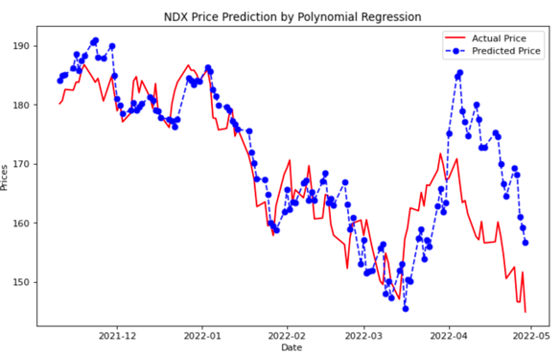
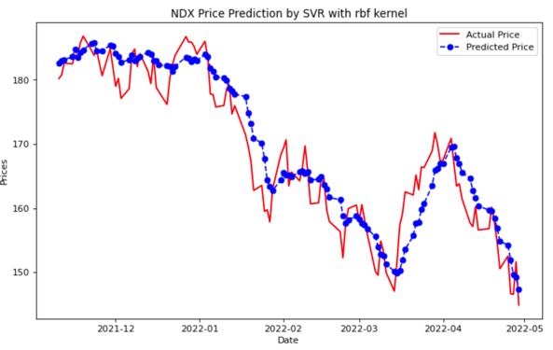


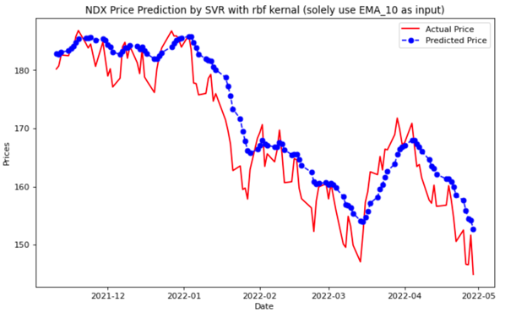

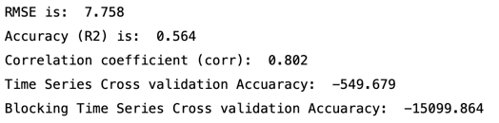
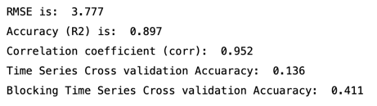
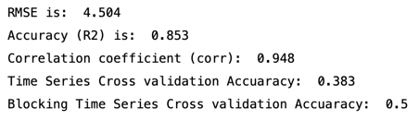
Classical learning modelling
Results
The poorest model with Polynomial Regression
The best model: SVR (with rbf kernel) incorporating macroeconomic factors
Good but not the best result when solely use EMA_10 as input
点击请替换文字内容
请替换文字内容，添加相关标题，修改文字内容，也可以直接复制你的内容到此。请替换文字内容，添加相关标题，修改文字内容，也可以直接复制你的内容到此。请替换文字内容，添加相关标题，修改文字内容，也可以直接复制你的内容到此。
点击请替换文字内容
请替换文字内容，添加相关标题，修改文字内容，也可以直接复制你的内容到此。请替换文字内容，添加相关标题，修改文字内容，也可以直接复制你的内容到此。请替换文字内容，添加相关标题，修改文字内容，也可以直接复制你的内容到此。
点击请替换文字内容
请替换文字内容，添加相关标题，修改文字内容，也可以直接复制你的内容到此。请替换文字内容，添加相关标题，修改文字内容，也可以直接复制你的内容到此。请替换文字内容，添加相关标题，修改文字内容，也可以直接复制你的内容到此。
Insight: the effectiveness of stock price prediction can be boosted if we integrated the macroeconomics factors as our input attributes

Slide 18
Summary
Key Findings:
SVR with ‘RBF’ kernel had an outstanding performance in stock price prediction
Incorporating macroeconomics factors can explicitly enhance Stock forecasting performance in classical learning models
Limitations and Future work:
Challenging to establish a robust model in actual market (psychological factors)
Power of the ARIMA model could be potentially leveraged by including seasonality and exogenous factors (i.e., SARIMAX model)
More advanced techniques could be adopted (e.g., neural network, deep learning, XGBoost)
Notes:
Reviewed sophisticated relationships behind the stock market particularly in this uncertain environment.
Real-life financial forecasting is often more complicated than the relationships described in the exploratory analysis section, but these depict a full picture of how the various actors play in the process of economic decision-making.
SVR with ‘RBF’ kernel had an outstanding performance among all classical learning models in stock price prediction (incorporating macroeconomic factors
Stock forecasting performance can be explicitly enhanced by placing macroeconomics factors as predicting attributes in classical learning models (polynomial regression and SVR with the ‘RBF’ kernel)
Limitations and Future work:
1. Challenging to predict the future in actual market, as machine learning model is difficult to predict the psychological factors of humans
2. Power of the ARIMA model could be potentially leveraged by including seasonality and exogenous factors (i.e., SARIMAX model).
3. more advanced techniques and tools could be adopted in future research, such as deep learning, neural network, XGBoost, etc

Slide 19
The END
THANK YOU
Acknowledgement: Prof William Marsh

